Slide 1
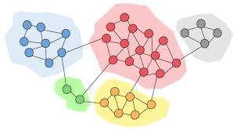
SPIN GLASS ALGORITHM FOR COMMUNITY DETECTION
Done by
Santhoshi R,
BE CSE,
PSG College of Technology

Slide 2
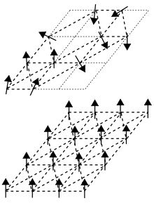
SPIN GLASS DETECTION ALGORITHM
Community detection is the process of identifying groups or clusters of nodes within a network that are more densely connected to each other than to the rest of the network.
The Spin Glass algorithm, inspired by statistical physics, models the network as a system of spins where each node is assigned a spin value. The goal is to find a low-energy configuration that corresponds to a good community structure.
Schematic representation of the
random spin structure of a spin
glass (top) and the ordered
one of a ferromagnet (bottom)

Slide 3

FORMULA:
The Hamiltonian 𝐻 of the system is given by:
where:
J_{ij}​ is the interaction strength between nodes i and j, set to +1 if there is an edge between the nodes, and 0 otherwise.
s_{i}​ and s_{j}​ are the spin values of nodes i and j, which can be +1 or −1.
The change in Hamiltonian ΔH when flipping the spin of a node is given by:
ΔH=H_{new} - H_{old}

Slide 4
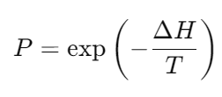
FORMULA:
The acceptance probability PPP for a spin flip that increases the Hamiltonian is given by:
where, T is the temperature of the system, which controls the likelihood of accepting higher-energy configurations to escape local minima.

Slide 5
SPIN GLASS ALGORITHM
Step 1 - Initialization: Assign random spins to each node.
Step 2 - Calculate Initial Hamiltonian: Compute the initial energy of the system.
Step 3 - Iteration:
3.1 Randomly select a node and flip its spin.
3.2 Calculate the new Hamiltonian and the change in energy (Δ𝐻).
3.3 Accept the spin flip if Δ𝐻≤0 or with probability 𝑃=exp⁡(−Δ𝐻 / 𝑇).
Step 4 - Convergence: Repeat the iteration until the Hamiltonian stabilizes or a maximum number of iterations is reached.

Slide 6
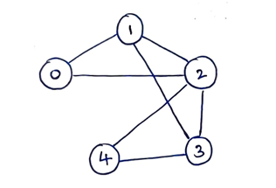
EXAMPLE PROBLEM:
Question :
Consider a graph with the following structure. Identify the communities with the initial spins [+1, -1, +1, -1, +1], Temperature(T) = 2.0(arbitrary units) and a probability threshold 0.5 (i.e) accept the spin if P<=0.5, reject otherwise. Show the steps for 5 iterations.
Solution : https://github.com/SanthoshiRavi/Spin-Glass-Community-Detection-Algorithm.git
(Refer PDF)

Slide 7
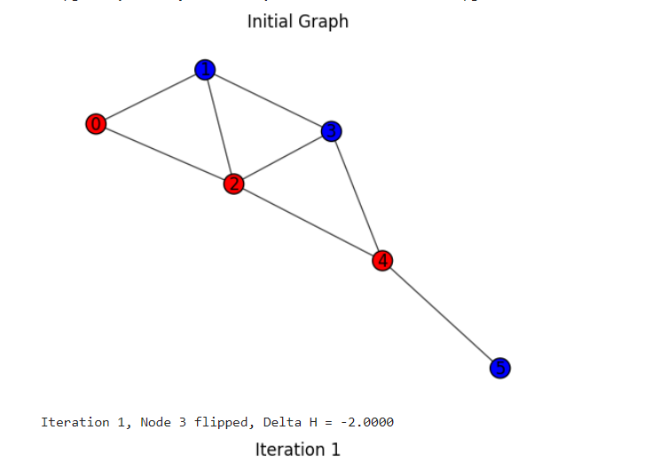
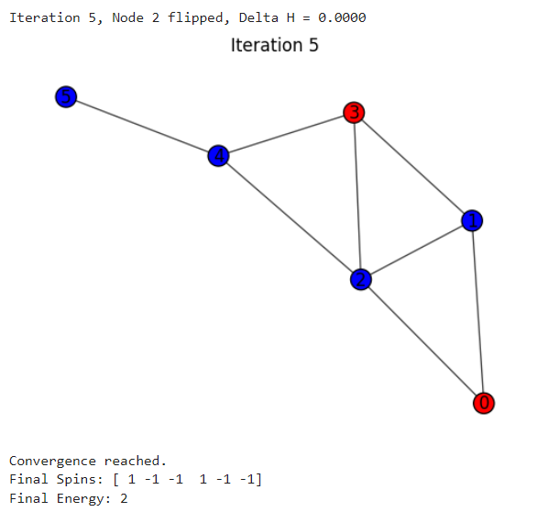
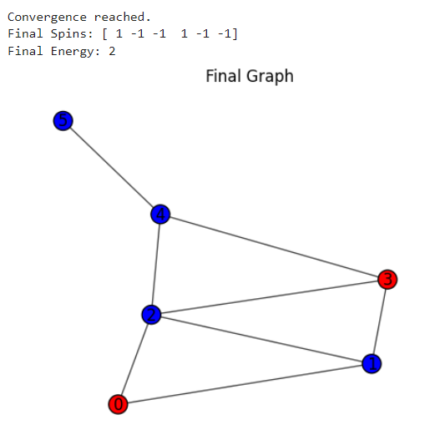
IMPLEMENTATION IN PYTHON:
https://colab.research.google.com/drive/1u22tQJ_BCN1-K9PSxZwFD9LL5bGXXKSN?usp=sharing
Sample output screenshots:

